Slide 1
Deep Learning Course
Improving Performance

Slide 2
Alternative Activations

Slide 3
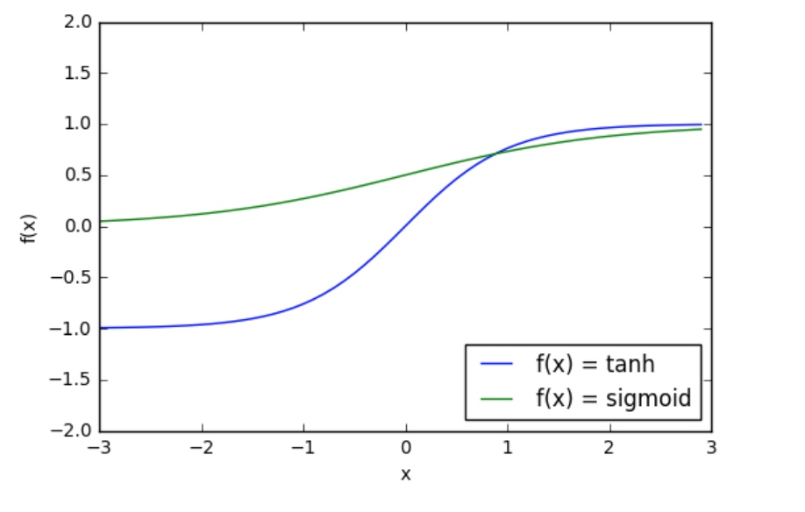
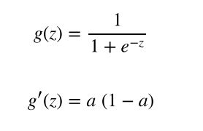
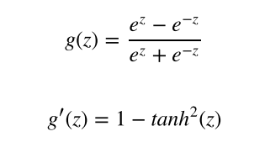
Hyperbolic Tangent Functions
Logistic Activation Function + Derivative
HTAN Activation Function + Derivative

Slide 4
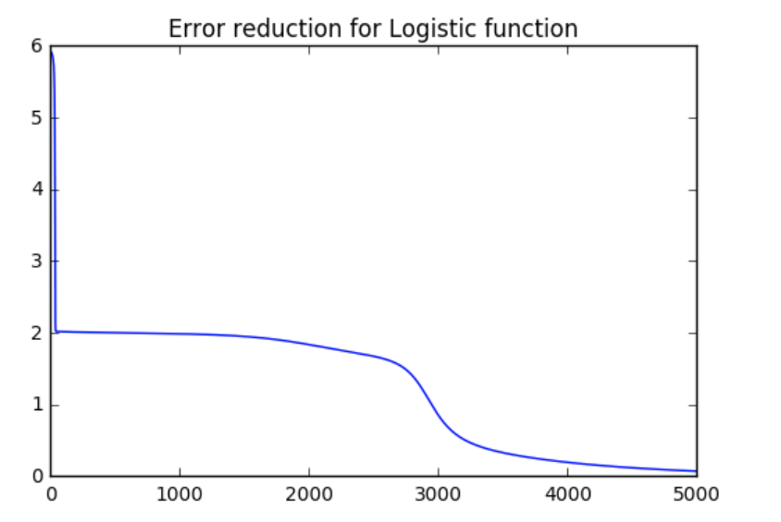
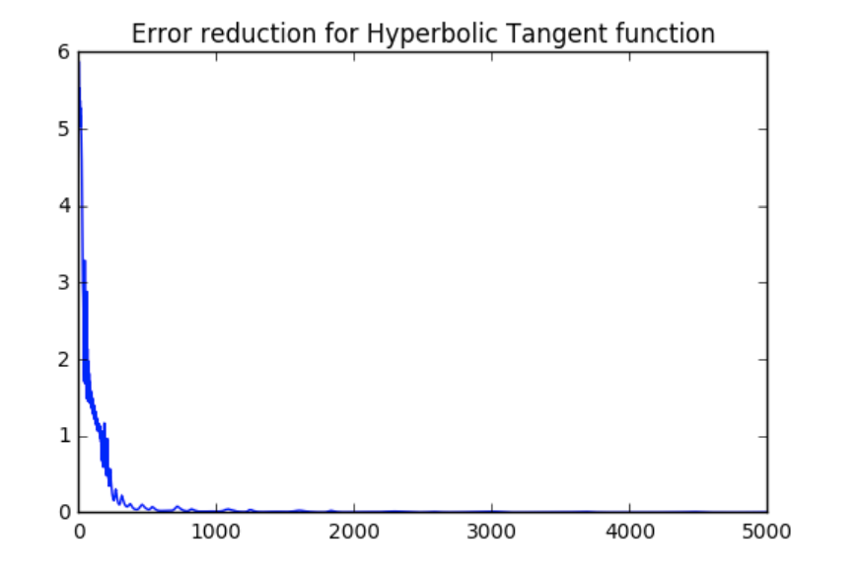
HTAN Performance

Slide 5
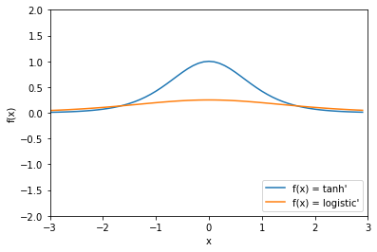
HTAN Performance - Cause

Slide 6
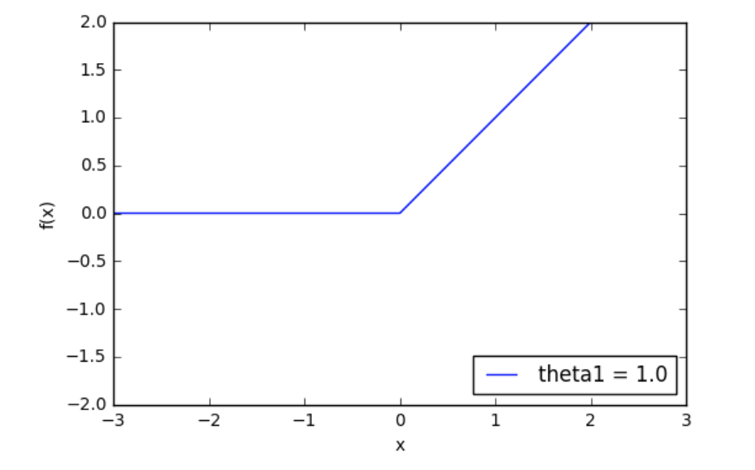
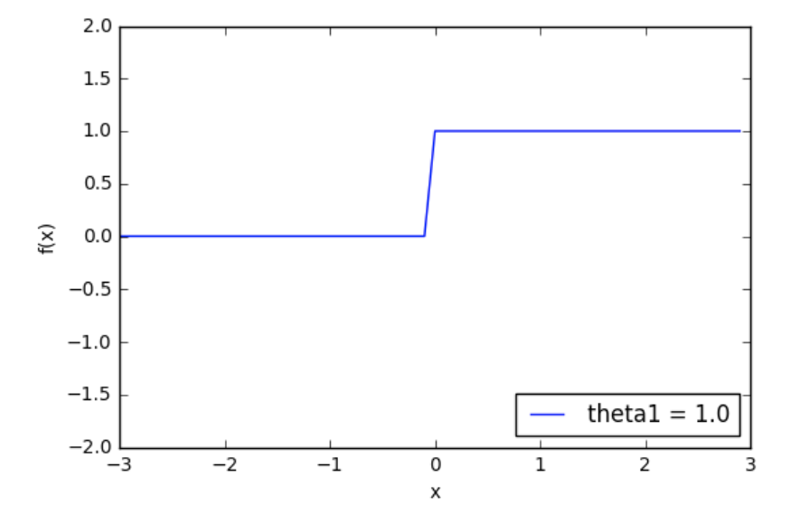


Rectified Linear Units

Slide 7
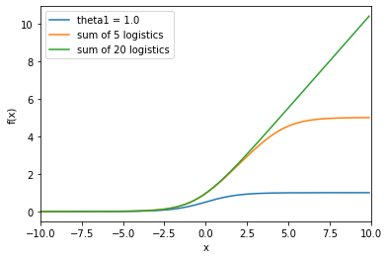
Rectified Linear Unit Performance Cause

Slide 8
Group Assignment
Split into small groups:
Within your group split in two, parts A and B. Part A should investigate Leaky RELU while part B should investigate clipping for RELU. Each group take 15 minutes to investigate their variety, and then two minutes each to inform the other half of the team.

Slide 9
Preventing Overfitting

Slide 10
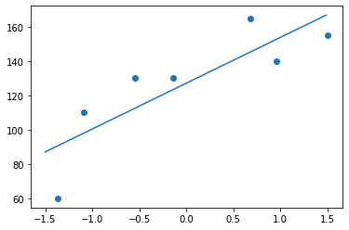
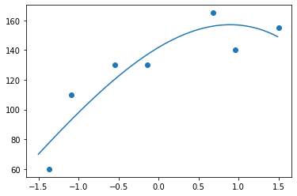
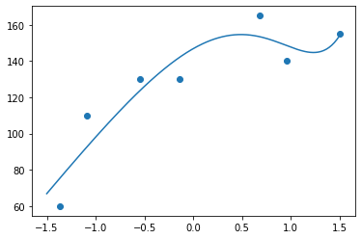
The Overfitting Problem - Example: Regression
Few Parameters - Reasonable Fit
More Parameters - Better Fit
Even More Parameters - Going too far????

Slide 11
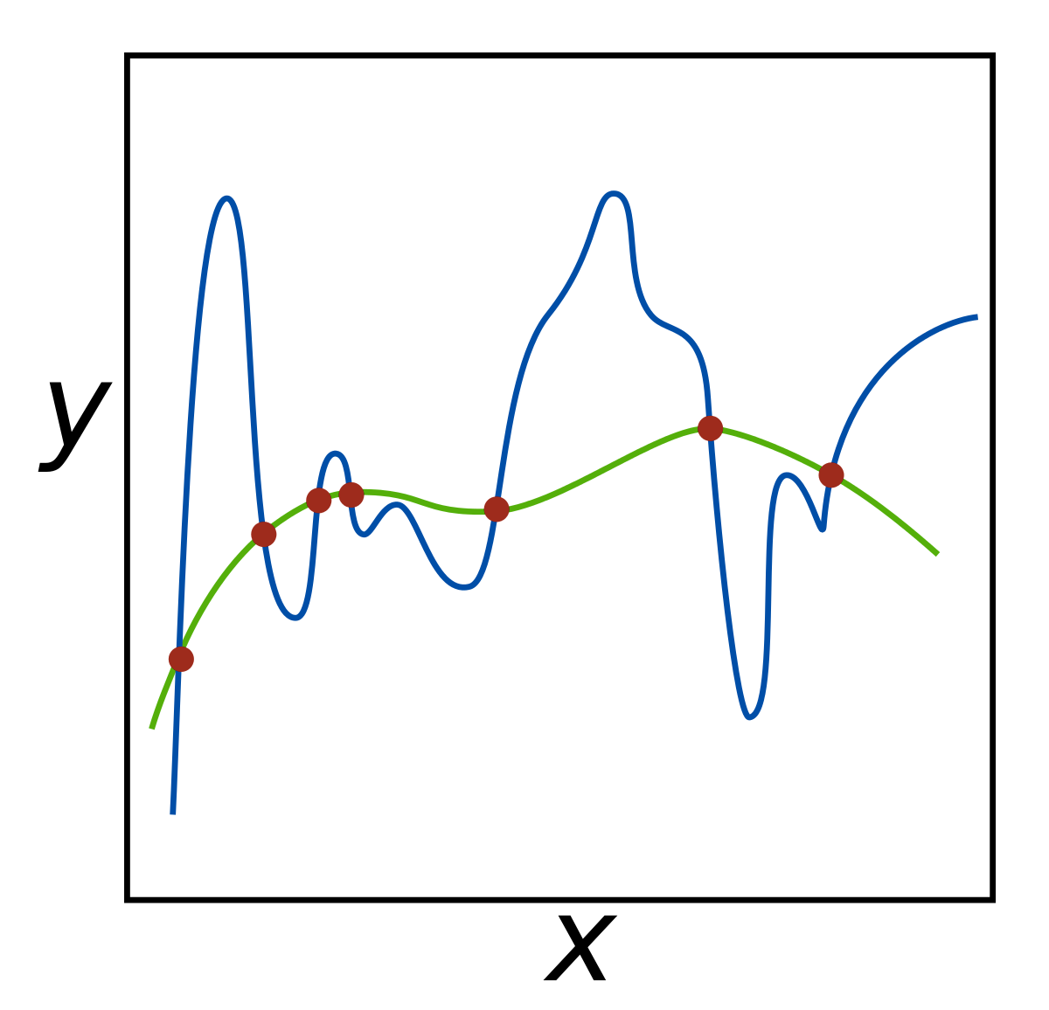
Overfitting Extreme Regression Case

Slide 12
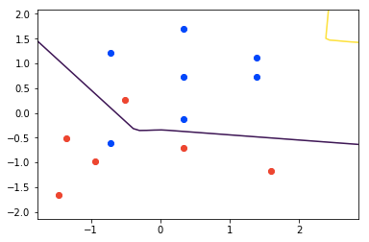
Overfitting in classification

Slide 13
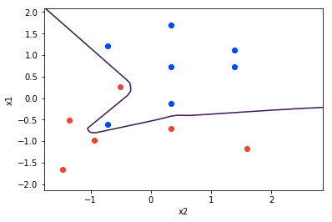
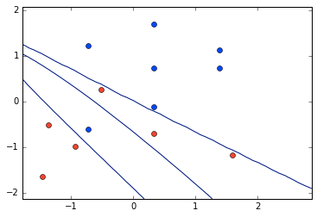
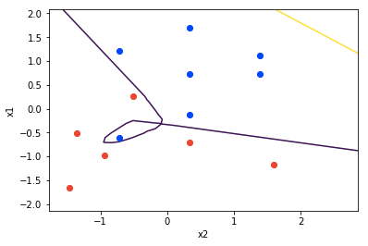
Overfitting on a Classification Task
Overfitting
Horrible Overfitting
A ‘better’ solution

Slide 14
Overfitting - Finding the Sweet Spot

Slide 15

Method 1: Regularization
Training_Cost = Actual_Error + Penalty_for_High_Weights
e.g., Sum of Squared Error or Cross Entropy Loss Function

Slide 16
Regularisation
Instead of just making our cost proportional to our actual error on training data, we can use a cost function which includes a part which is proportional to the magnitude of parameters.
Regularisation penalizes extreme parameters and in so doing helps to stop overfitting.
Cost function combining MSE and L2 regularisation

Slide 17
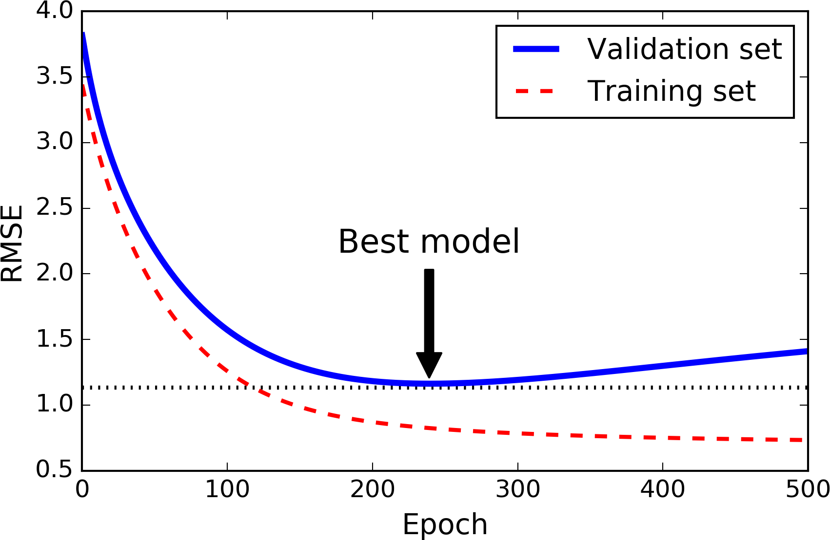
Method 2: Early Stopping

Slide 18
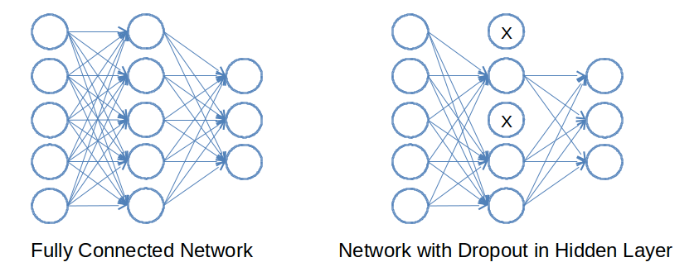
Method 3: Dropout

Slide 19
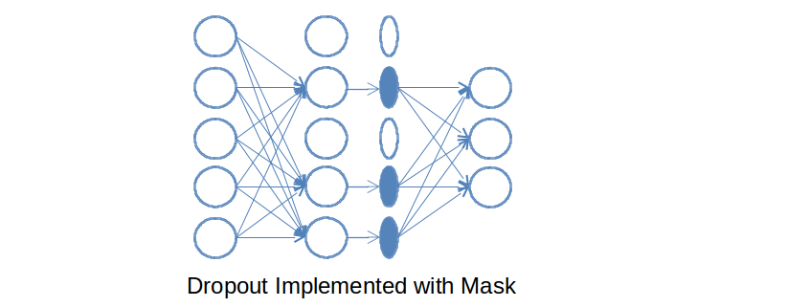
Dropout Mask

Slide 20
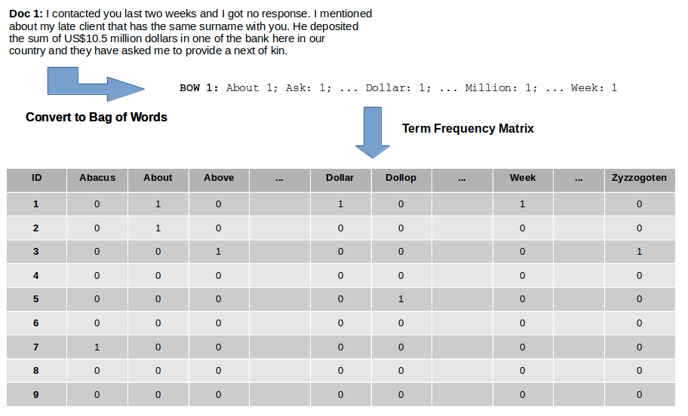
Text Representation

Slide 21
Group Assignment
Split into small groups:
Use your own dataset of choice to investigate Dropout and Early Stopping. This dataset can be a text dataset or perhaps a vision or business data dataset.

